Slide 1
Food Junkies
Chuk Ho Wu, Szymon Późniewski, Ivelisse Morales, Kah Hau Yap, Gurjot Singh Nijjar

Slide 2
Languages & Platforms
Objective C, C++, Java
iOS, Android

Slide 3
Our users
Indecisive, picky eater and people looking to discover new foods

Slide 4
Problems
Too many food options leading to inability to decide on food
Time and money limiting food choices
Lack of knowledge of different kinds of foods

Slide 5
vision
An application providing quick and easy recommendations based on user preference and history

Slide 6
strategy
Establish what the user cannot eat
Establish a base for users tastes and preferences
Give recommendations based on provided information and filters

Slide 7
Strategy cont.
Gather feedback on new food the user has tried
Incorporate new data into users tastes
Give recommendations using updated info and filters

Slide 8
goal
Provide quick results that relate to users tastes

Slide 9
features
Recommendations based on likes
Option to discover new foods
Search option

Slide 10
Other tools
Yelp API
Google Maps API
OpenMenu API

Slide 11
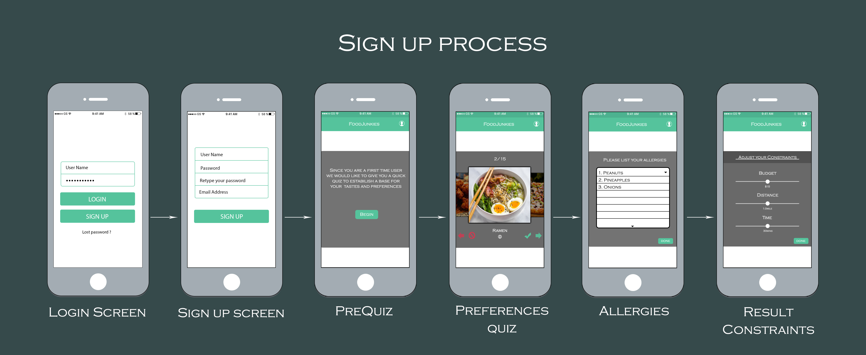
Wireframe Design - Part 1

Slide 12
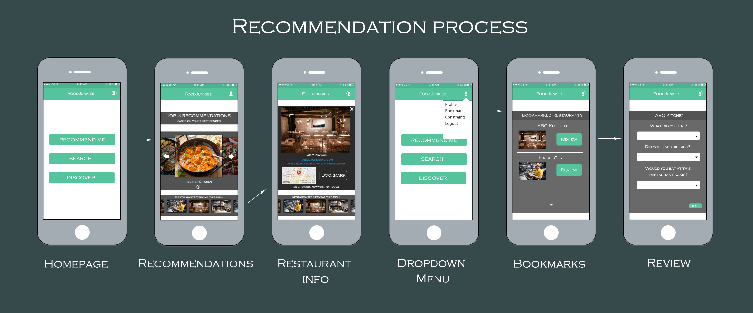
Wireframe Design - Part 1

Slide 13
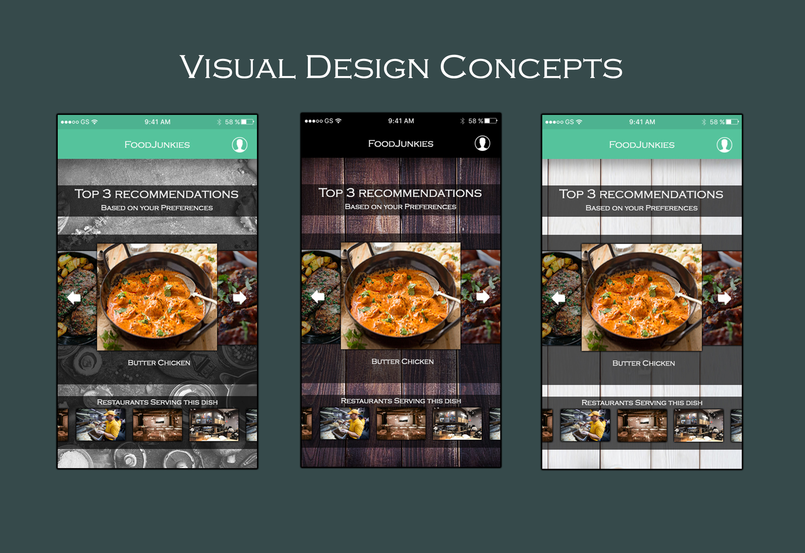

Slide 14
